Slide 1
Applied Cryptography Advanced Encryption Standard (AES)
Liangfeng Zhang
School of Information Science and Technology
ShanghaiTech University

Slide 2


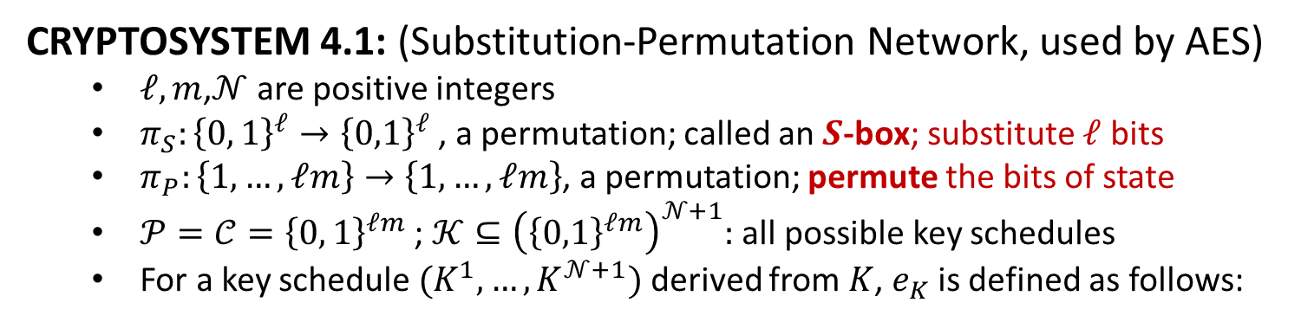









Substitution-Permutation Network
CRYPTOSYSTEM 4.1: (Substitution-Permutation Network, used by AES)
$ℓ,m$,$𝒩$ are positive integers
$π_{S}:{\left\{0, 1\right\}}^{ℓ}→{\left\{0,1\right\}}^{ℓ}$, a permutation; called an $S$-box; substitute $ℓ$ bits
$π_{P}:\left\{1,…,ℓm\right\}→\left\{1,…,ℓm\right\}$, a permutation; permute the bits of state
$𝒫=𝒞={\left\{0, 1\right\}}^{ℓm}$ ; $𝒦⊆{\left({\left\{0,1\right\}}^{ℓm}\right)}^{𝒩+1}:$ all possible key schedules
For a key schedule $(K^{1}, …, K^{𝒩+1})$ derived from $K$, $e_{K}$ is defined as follows:
$$x=(x_{1},x_{2},…,x_{ℓm})$$
$$x_{〈1〉}$$
$$x_{〈2〉}$$
$$⋯$$
$$x_{〈m〉}$$
$$⋯$$
$ℓ$ bits
$ℓ$ bits
$$⋯$$
$ℓ$ bits
$$x_{〈i〉}=(x_{\left(i−1\right)ℓ+1},…,x_{iℓ})$$

Slide 3














































$$ℓ=m=4$$
$$n=ℓm$$
$$n=ℓm$$
$$K$$
$$x$$
$$K^{1}$$
$$⊕$$
key schedule
1
$$π_{S}$$
$$π_{S}$$
$$π_{S}$$
$$π_{S}$$
$$π_{P}$$
$$w^{1}$$
$$K^{2}$$
$$⊕$$
2
$$π_{S}$$
$$π_{S}$$
$$π_{S}$$
$$π_{S}$$
$$π_{P}$$
$$w^{2}$$
$$⋮$$
$$⋮$$
$$⋮$$
$$⋮$$
$$⋮$$
$$⋮$$
$$⋮$$
$$⋮$$
$$⋮$$
$$⋮$$
$$⋮$$
$$⋮$$
$$⋮$$
$$⋮$$
$$⋮$$
$$⋮$$
$$⋮$$
$$⋮$$
$$K^{𝒩−1}$$
$$⊕$$
$$𝒩−1$$
$$π_{S}$$
$$π_{S}$$
$$π_{S}$$
$$π_{S}$$
$$⋯$$
$$π_{P}$$
$$w^{𝒩−1}$$
$$K^{𝒩}$$
$$⊕$$
$$𝒩$$
$$π_{S}$$
$$π_{S}$$
$$π_{S}$$
$$π_{S}$$
$$⋯$$
$$K^{𝒩+1}$$
$$⊕$$
$$y$$

Slide 4









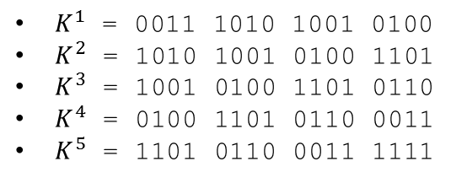






















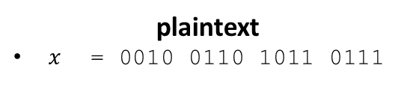






















$$x$$
$$K_{〈1〉}^{1}$$
$$K_{〈2〉}^{1}$$
$$K_{〈3〉}^{1}$$
$$K_{〈4〉}^{1}$$
$$u^{1}$$
EXAMPLE
$$S_{1}^{1}$$
$$S_{2}^{1}$$
$$S_{3}^{1}$$
$$S_{4}^{1}$$
$$ℓ=m=𝒩=4$$
$$v^{1}$$
$$z$$ | $$0$$ | $$1$$ | $$2$$ | $$3$$ | $$4$$ | $$5$$ | $$6$$ | $$7$$ | $$8$$ | $$9$$ | $$A$$ | $$B$$ | $$C$$ | $$D$$ | $$E$$ | $$F$$
$$π_{S}(z)$$ | $$E$$ | $$4$$ | $$D$$ | $$1$$ | $$2$$ | $$F$$ | $$B$$ | $$8$$ | $$3$$ | $$A$$ | $$6$$ | $$C$$ | $$5$$ | $$9$$ | $$0$$ | $$7$$
$$w^{1}$$
$$K_{〈1〉}^{2}$$
$$K_{〈2〉}^{2}$$
$$K_{〈3〉}^{2}$$
$$K_{〈4〉}^{2}$$
$s_{j}^{i}$ are all equal to $π_{S}$
$$u^{2}$$
$$S_{1}^{2}$$
$$S_{2}^{2}$$
$$S_{3}^{2}$$
$$S_{4}^{2}$$
$$z$$ | $$1$$ | $$2$$ | $$3$$ | $$4$$ | $$5$$ | $$6$$ | $$7$$ | $$8$$ | $$9$$ | $$10$$ | $$11$$ | $$12$$ | $$13$$ | $$14$$ | $$15$$ | $$16$$
$$π_{P}(z)$$ | $$1$$ | $$5$$ | $$9$$ | $$13$$ | $$2$$ | $$6$$ | $$10$$ | $$14$$ | $$3$$ | $$7$$ | $$11$$ | $$15$$ | $$4$$ | $$8$$ | $$12$$ | $$16$$
$$v^{2}$$
$K$= 0011 1010 1001 0100 1101 0110 0011 1111
$$w^{2}$$
$$K_{〈1〉}^{3}$$
$$K_{〈2〉}^{3}$$
$$K_{〈3〉}^{3}$$
$$K_{〈4〉}^{3}$$
Key schedule: choose 16 consecutive bits
$$u^{3}$$
$$S_{1}^{3}$$
$$S_{2}^{3}$$
$$S_{3}^{3}$$
$$S_{4}^{3}$$
$K^{1}$ = 0011 1010 1001 0100
$K^{2}$ = 1010 1001 0100 1101
$K^{3}$ = 1001 0100 1101 0110
$K^{4}$ = 0100 1101 0110 0011
$K^{5}$ = 1101 0110 0011 1111
$$v^{3}$$
$$w^{3}$$
$$K_{〈1〉}^{4}$$
$$K_{〈2〉}^{4}$$
$$K_{〈3〉}^{4}$$
$$K_{〈4〉}^{4}$$
$$u^{4}$$
plaintext
$x$ = 0010 0110 1011 0111
$$S_{1}^{4}$$
$$S_{2}^{4}$$
$$S_{3}^{4}$$
$$S_{4}^{4}$$
$$v^{4}$$
$$K_{〈1〉}^{5}$$
$$K_{〈2〉}^{5}$$
$$K_{〈3〉}^{5}$$
$$K_{〈4〉}^{5}$$
$$y$$

Slide 5

















$$x$$
0010
0110
1011
0111
0011
1010
1001
0100
$$u^{1}$$
0001
1100
0010
0011
EXAMPLE
$$S_{1}^{1}$$
$$S_{2}^{1}$$
$$S_{3}^{1}$$
$$S_{4}^{1}$$
$$ℓ=m=𝒩=4$$
$$v^{1}$$
0100
0101
1101
0001
0010
1110
0000
0111
$$z$$ | $$0$$ | $$1$$ | $$2$$ | $$3$$ | $$4$$ | $$5$$ | $$6$$ | $$7$$ | $$8$$ | $$9$$ | $$A$$ | $$B$$ | $$C$$ | $$D$$ | $$E$$ | $$F$$
$$π_{S}(z)$$ | $$E$$ | $$4$$ | $$D$$ | $$1$$ | $$2$$ | $$F$$ | $$B$$ | $$8$$ | $$3$$ | $$A$$ | $$6$$ | $$C$$ | $$5$$ | $$9$$ | $$0$$ | $$7$$
$$w^{1}$$
1010
1001
0100
1101
$s_{j}^{i}$ are all equal to $π_{S}$
$$u^{2}$$
1000
0111
0100
1010
$$S_{1}^{2}$$
$$S_{2}^{2}$$
$$S_{3}^{2}$$
$$S_{4}^{2}$$
$$z$$ | $$1$$ | $$2$$ | $$3$$ | $$4$$ | $$5$$ | $$6$$ | $$7$$ | $$8$$ | $$9$$ | $$10$$ | $$11$$ | $$12$$ | $$13$$ | $$14$$ | $$15$$ | $$16$$
$$π_{P}(z)$$ | $$1$$ | $$5$$ | $$9$$ | $$13$$ | $$2$$ | $$6$$ | $$10$$ | $$14$$ | $$3$$ | $$7$$ | $$11$$ | $$15$$ | $$4$$ | $$8$$ | $$12$$ | $$16$$
$$v^{2}$$
0011
1000
0010
0110
0100
0001
1011
1000
$K$= 0011 1010 1001 0100 1101 0110 0011 1111
$$w^{2}$$
1001
0100
1101
0110
Key schedule: choose 16 consecutive bits
$$u^{3}$$
1101
0101
0110
1110
$$S_{1}^{3}$$
$$S_{2}^{3}$$
$$S_{3}^{3}$$
$$S_{4}^{3}$$
$K^{1}$ = 0011 1010 1001 0100
$K^{2}$ = 1010 1001 0100 1101
$K^{3}$ = 1001 0100 1101 0110
$K^{4}$ = 0100 1101 0110 0011
$K^{5}$ = 1101 0110 0011 1111
$$v^{3}$$
1001
1111
1011
0000
$$w^{3}$$
1110
0100
0110
1110
0100
1101
0110
0011
$$u^{4}$$
1010
1001
0000
1101
plaintext
$x$ = 0010 0110 1011 0111
$$S_{1}^{4}$$
$$S_{2}^{4}$$
$$S_{3}^{4}$$
$$S_{4}^{4}$$
$$v^{4}$$
0110
1010
1110
1001
1101
0110
0011
1111
$$y$$
1011
1100
1101
0110

Slide 7
The Selection of AES
01/02/1997: NIST began the process of choosing a replacement for DES
NIST: National Institute of Standards and Technology
DES: Data Encryption Standard
09/12/1997: NIST made formal call for AES-Advanced Encryption Standard
06/15/1998: 21 submissions were received all over the world
08/20/1998: 1st AES Candidate Conference; 15 submissions chosen
03/22/1999: 2nd AES Candidate Conference
08/09/1999: NIST announced 5 candidates as the finalists
MARS, RC6, Rijndael, Serpent, Twofish
04/13/2000: 3rd AES Candidate Conference
10/02/2000: Rijndael was selected as AES
Proposed by Daemen and Rijmen, Belgian researchers
02/28/2001: NIST announced FIPS draft for AES
FIPS: federal information processing standard
11/26/2001: AES was adopted as a standard
12/04/2001: AES was published as FIPS 197.

Slide 8
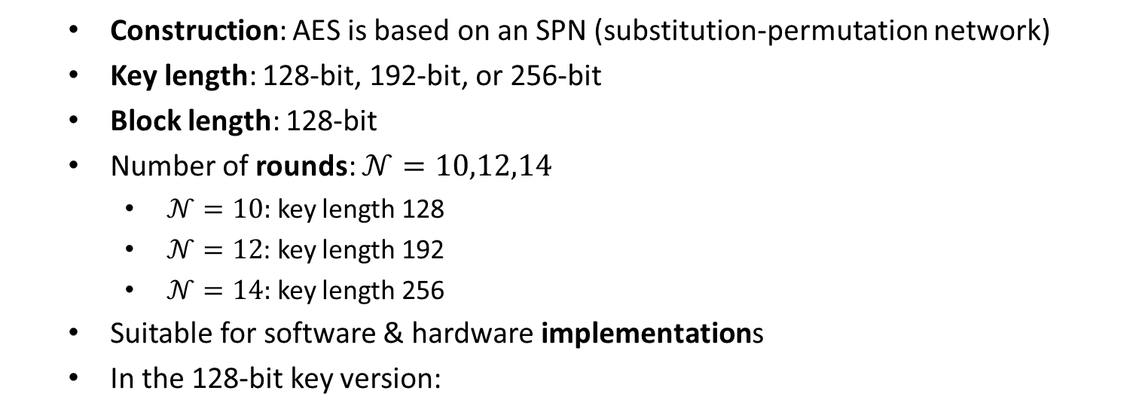
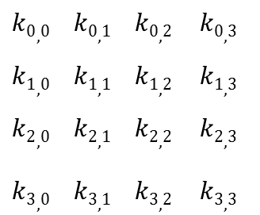
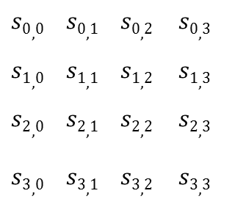
Basics of AES
Construction: AES is based on an SPN (substitution-permutation network)
Key length: 128-bit, 192-bit, or 256-bit
Block length: 128-bit
Number of rounds: $𝒩=10,12,14$
$𝒩=10:$ key length 128
$𝒩=12$: key length 192
$𝒩=14:$ key length 256
Suitable for software & hardware implementations
In the 128-bit key version:
$$s0,0 s0,1 s0,2 s0,3$$
$$s1,0 s1,1 s1,2 s1,3$$
$$s2,0 s2,1 s2,2 s2,3$$
$$s3,0 s3,1 s3,2 s3,3$$
$$k0,0 k0,1 k0,2 k0,3$$
$$k1,0 k1,1 k1,2 k1,3$$
$$k2,0 k2,1 k2,2 k2,3$$
$$k3,0 k3,1 k3,2 k3,3$$
State (16 bytes)
Key (16 Bytes)

Slide 9

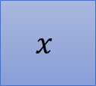



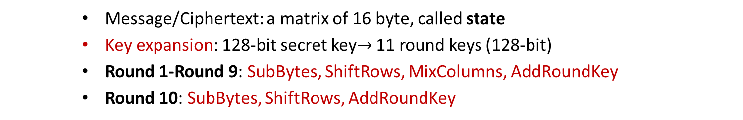


AES Encryption
128-bit
secret key $K$
Key expansion
$$K^{0}$$
$$K^{1}$$
$$K^{2}$$
$$K^{10}$$
128-bit round keys
AddRoundKey
4
4
SubBytes
ShiftRows
MixColumns
SubBytes
ShiftRows
MixColumns
SubBytes
ShiftRows
$$x$$
⨁
$$y$$
4
⨁
⨁
⨁
⨁
4
Round 1
Round 2
Round 10
Message/Ciphertext: a matrix of 16 byte, called state
Key expansion: 128-bit secret key$→$ 11 round keys (128-bit)
Round 1-Round 9: SubBytes, ShiftRows, MixColumns, AddRoundKey
Round 10: SubBytes, ShiftRows, AddRoundKey

Slide 10
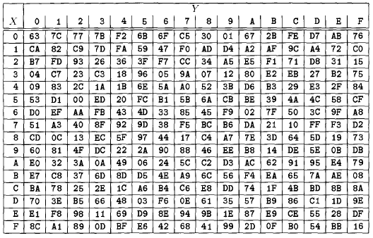
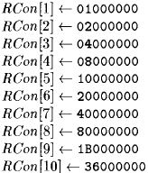


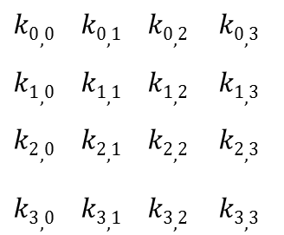



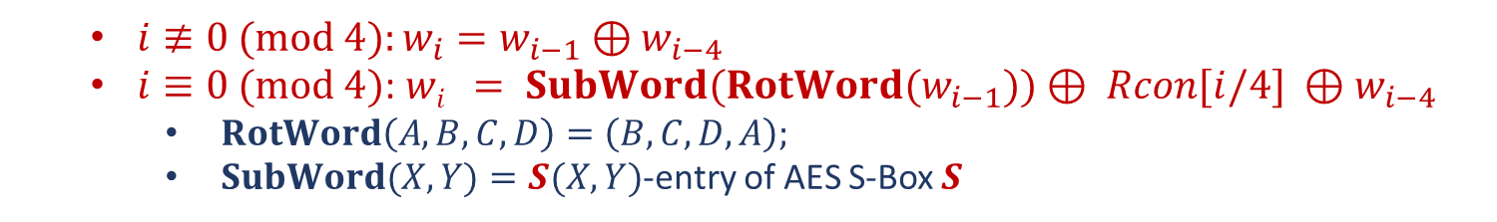


Key Expansion
$$K$$
$S$: AES S-Box
Constants
$$k0,0 k0,1 k0,2 k0,3$$
$$k1,0 k1,1 k1,2 k1,3$$
$$k2,0 k2,1 k2,2 k2,3$$
$$k3,0 k3,1 k3,2 k3,3$$
$$w0 w1 w2 w3 w4 w5 w6 w7 w8 w9 w42 w43$$
$$⋯$$
$$K^{0}$$
$$K^{1}$$
$$K^{2}$$
$$K^{10}$$
$i≢0 (mod 4):w_{i}=w_{i−1}⊕w_{i−4}$
$i≡0 (mod 4)$: $wi = SubWord(RotWord(w_{i−1}))⊕ Rcon[i/4] ⊕w_{i−4}$
$RotWord\left(A,B,C,D\right)=\left(B,C,D,A\right);$
$SubWord(X,Y)=S(X,Y)$-entry of AES S-Box $S$

Slide 11
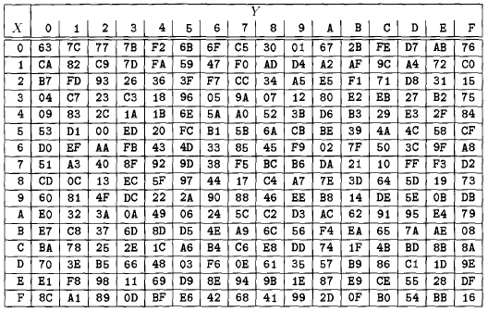
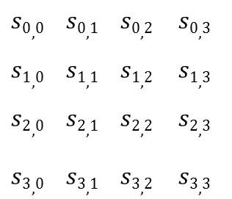

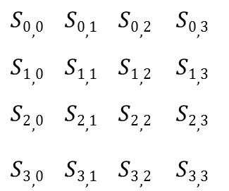
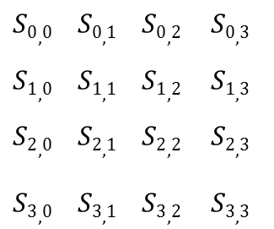
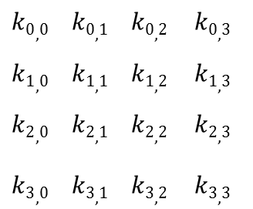

AddRoundKey and SubBytes
AddRoundKey($s,K^{i}$): XOR the state $s$ with the round key $K^{i}$
$$s0,0 s0,1 s0,2 s0,3$$
$$s1,0 s1,1 s1,2 s1,3$$
$$s2,0 s2,1 s2,2 s2,3$$
$$s3,0 s3,1 s3,2 s3,3$$
$$k0,0 k0,1 k0,2 k0,3$$
$$k1,0 k1,1 k1,2 k1,3$$
$$k2,0 k2,1 k2,2 k2,3$$
$$k3,0 k3,1 k3,2 k3,3$$
$$S0,0 S0,1 S0,2 S0,3$$
$$S1,0 S1,1 S1,2 S1,3$$
$$S2,0 S2,1 S2,2 S2,3$$
$$S3,0 S3,1 S3,2 S3,3$$
$$→$$
SubBytes($s$): $\left(X,Y\right)←S\left(X,Y\right), \left(X,Y\right)=s_{i,j}$ is any entry of the state
$$s0,0 s0,1 s0,2 s0,3$$
$$s1,0 s1,1 s1,2 s1,3$$
$$s2,0 s2,1 s2,2 s2,3$$
$$s3,0 s3,1 s3,2 s3,3$$
$$S0,0 S0,1 S0,2 S0,3$$
$$S1,0 S1,1 S1,2 S1,3$$
$$S2,0 S2,1 S2,2 S2,3$$
$$S3,0 S3,1 S3,2 S3,3$$
$$→$$

Slide 12
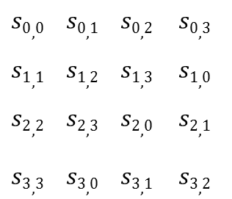

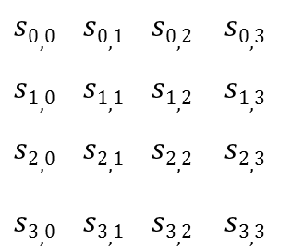

ShiftRows and MixColumns
ShiftRows($s$): shift the rows of the state to the left
$$s0,0 s0,1 s0,2 s0,3$$
$$s1,0 s1,1 s1,2 s1,3$$
$$s2,0 s2,1 s2,2 s2,3$$
$$s3,0 s3,1 s3,2 s3,3$$
$$s0,0 s0,1 s0,2 s0,3$$
$$s1,1 s1,2 s1,3 s1,0$$
$$s2,2 s2,3 s2,0 s2,1$$
$$s3,3 s3,0 s3,1 s3,2$$
$$→$$
MixColumns($s$): Multiplications over $𝔽_{2^{8}}$
02 03 01 01
01 02 03 01
01 01 02 03
03 01 01 02
$$s0,0 s0,1 s0,2 s0,3$$
$$s1,0 s1,1 s1,2 s1,3$$
$$s2,0 s2,1 s2,2 s2,3$$
$$s3,0 s3,1 s3,2 s3,3$$
$$S0,0 S0,1 S0,2 S0,3$$
$$S1,0 S1,1 S1,2 S1,3$$
$$S2,0 S2,1 S2,2 S2,3$$
$$S3,0 S3,1 S3,2 S3,3$$
*
$$→$$

Slide 13
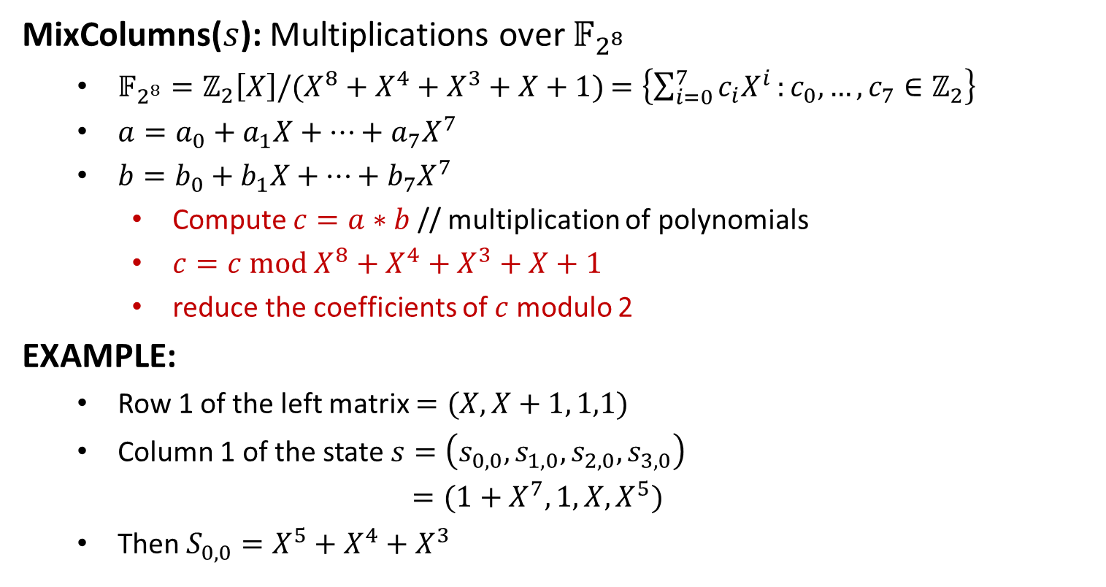
MixColumns
MixColumns($s$): Multiplications over $𝔽_{2^{8}}$
$𝔽_{2^{8}}=ℤ_{2}\left[X\right]/(X^{8}+X^{4}+X^{3}+X+1)$ $=\left\{\sum_{i=0}^{7}{c_{i}X^{i}}:c_{0},…,c_{7}∈ℤ_{2}\right\}$
$a=a_{0}+a_{1}X+⋯+a_{7}X^{7}$
$b=b_{0}+b_{1}X+⋯+b_{7}X^{7}$
Compute $c=a∗b$ // multiplication of polynomials
$c=c mod X^{8}+X^{4}+X^{3}+X+1$
reduce the coefficients of $c$modulo 2
EXAMPLE:
Row 1 of the left matrix $=(X, X+1, 1,1)$
Column 1 of the state $s=\left(s_{0,0},s_{1,0},s_{2,0},s_{3,0}\right)$
$=(1+X^{7}, 1,X,X^{5})$
Then $S_{0,0}=X^{5}+X^{4}+X^{3}$

